Slide 1
ANGULAR 7 FEATURES
MADDIKARA SAI TRIVENI
ID:-5067623

Slide 2
OBJECTIVES
Features of angular 7
Animations
Material
Guards

Slide 3
Introdction
One of the most popular Javascript framework ANGULAR has released its SEVENTH VERSION (Angular 7). This new release of the web application development framework has bought certain attractive features that made this framework unique as compared to its previous versions. In this Angular 7 tutorial, we will discuss the top 10 Angular 7 features.

Slide 4
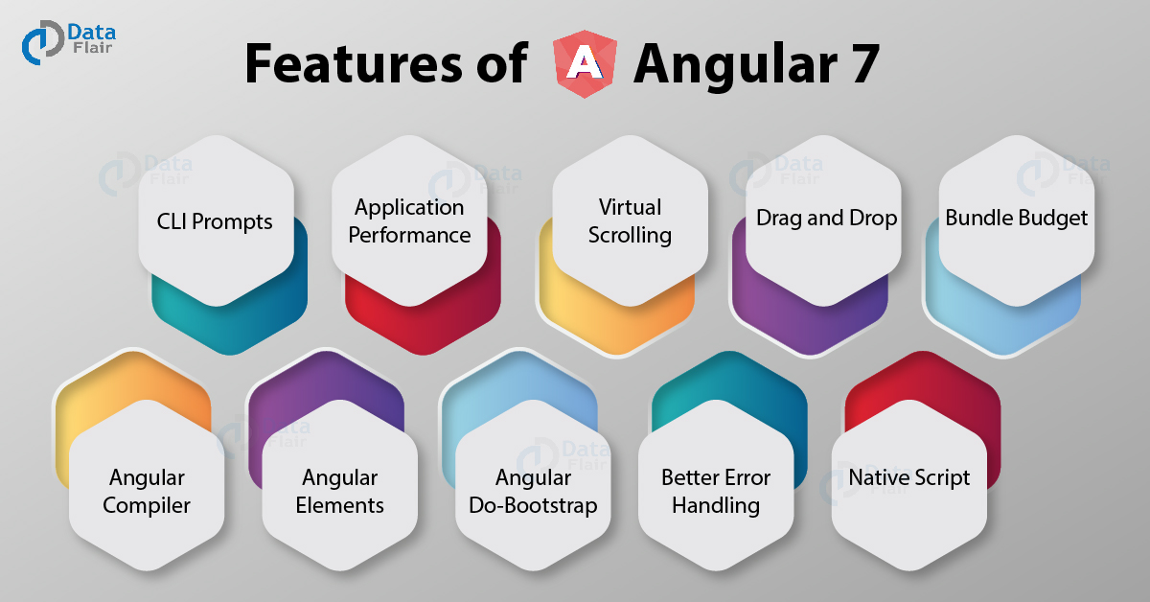

Slide 5
Features of Angular 7 are:
1. CLI Prompts
In angular 7, the command line interface (CLI) prompts has been modernized to version 7.0.2. With the new and updated version of angular CLI comes new features. When the user executes common commands like ng add @angular/material or ng new, it will prompt users. It helps users to explore the in-built SCSS support, routing, etc. To benefit all packages that publish schematics, CLI prompts have been added to schematics too.
2. Application Performance
Angular 7 is faster as compared to the previous versions of angular. Certain new features introduced as discussed above makes the app run faster and perform better. It does not only focus on making framework small but makes the app small too as much as possible. In version 7 the reflect-metadata polyfill (includes in production) remove automatically.
3. Virtual Scrolling
Scrolling feature was present in the previous version of angular (angular 6). Angular 7 comes with virtual scrolling. Virtual scrolling allows users to bind a list of elements even its too long in small packets. As per the scroll movements, data will be supplied into packets at the user end. This is one of the Angular 7 features, which is beneficial for mobile apps where scrolling can affect performance. But useful for web applications too as even in web applications if we scroll a long list of data, performance gets affected.

Slide 6
4. Drag and Drop
Now even by dragging and dropping items in the list user can re-order the list. It also allows the transfer of elements between the lists. Using CDK drag handle, a user can customize the drag area as per requirement. Multiple handles apply on a single item if requires. As per the user’s command, the item may move along the X-axis or the Y-axis because the movement of drag and drop restricts along an axis.
5. Bundle Budget
While developing applications on Angular 7, now the developers can set up a budget limit of their bundle size. a default setting of the bundled budget has 2 MB as the lower limit and 5 MB as the higher limit. When the initial bundle is more than 2MB, a new application will warn and will error at 5 MB. The developer can also change these settings as per need. Reduction in bundle size improves the performance of the application.
6. Angular Compiler
The new angular compiler offers an 8-phase rotating ahead-of-time compilation. The NGCC (Angular Compatibility Compiler) will convert node_modules compiled with Angular Compatibility Compiler (NGCC), into node_modules which appear to have been composed with TSC compiler transformer (NTSC). Also, Ivy rendering engine can use such “legacy” package due to this compiler change
7. Angular Elements
It was introduced in the Angular 6. Since a part of the Angular framework, the angular 7 comes with its new updates. Angular now supports content projection using web standard for custom elements.

Slide 7
8. Angular Do-Bootstrap
It uses to bootstrap those modules which require bootstrap of components. Angular 7 offers interface (DoBootstrap) and new life-cycle hoop (ngDoBootstrap).
9. Better Error Handling
Angular 7 improves error handling in an angular application. @Output in angular7.0 has an improved error handling feature.
10. Native Script
Before Angular 7 developers have to create separate projects for mobile and web version of the application but Now through a single project, users can build a web and mobile app too. A native script schematics collection provide this functionality. The codes for the web and mobile apps will maintain in such a way that the shareable part keep at one place and non-shareable ones can create separately but in a single project.

Slide 8
Animation
Animations add a lot of interaction between the html elements. Animation was available with Angular 2, from Angular 4 onwards animation is no more a part of the @angular/core library, but is a separate package that needs to be imported in app.module.ts.

Slide 9
To start with, we need to import the library with the below line of code

Slide 10
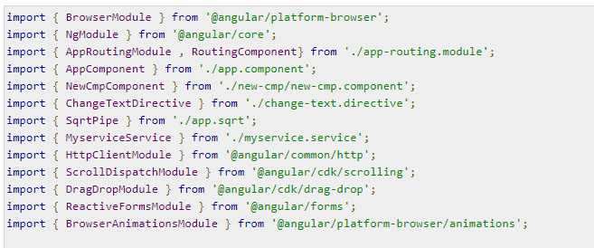
The BrowserAnimationsModule needs to be added to the import array in app.module.ts as shown below −

Slide 11
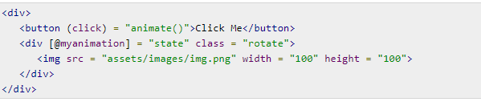
In app.component.html, we have added the html elements, which are to be animated.
Let us now see the app.component.ts where the animation is defined.

Slide 12
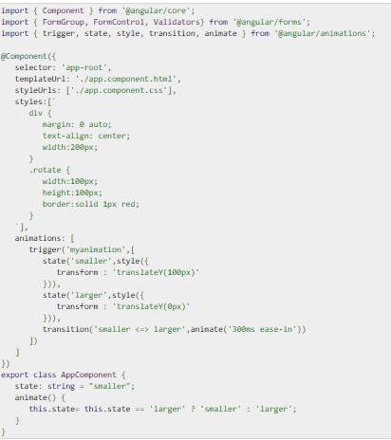

Slide 13
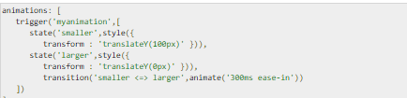
We have to import the animation function that is to be used in the .ts file as shown above.
Here we have imported trigger, state, style, transition, and animate from @angular/animations.
Now, we will add the animations property to the @Component () decorator −

Slide 14

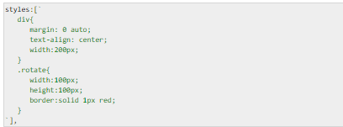
Let us now see the .html file to see how the transition function works −
There is a style property added in the @component directive, which centrally aligns the div. Let us consider the following example to understand the same −

Slide 15

Here, a special character [``] is used to add styles to the html element, if any. For the div, we have given the animation name defined in the app.component.ts file.
On the click of a button it calls the animate function, which is defined in the app.component.ts file as follows −

Slide 16
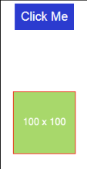
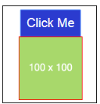
This is how the output in the browser (http://localhost:4200/) will look like −

Slide 17

Materials
Materials offer a lot of built-in modules for your project. Features such as autocomplete, datepicker, slider, menus, grids, and toolbar are available for use with materials in Angular 7.
To use materials, we need to import the package. Angular 2 also has all the above features but they are available as part of the @angular/core module. From Angular 4, Materials module has been made available with a separate module @angular/materials. This helps the user to import only the required materials in their project.
Following is the command to add materials to your project −

Slide 18
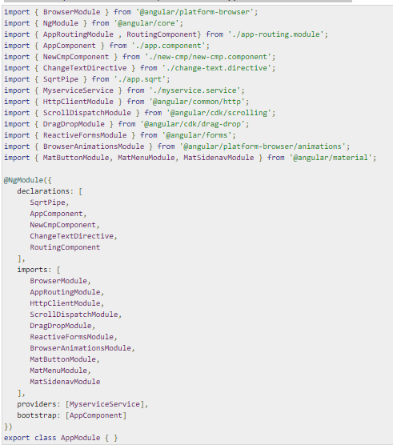
We will now import the modules in the parent module - app.module.ts as shown below.

Slide 19
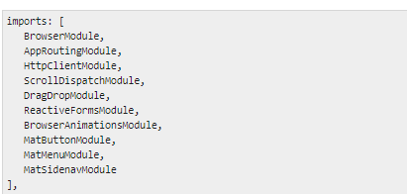
In the above file, we have imported the following modules from @angular/materials.
And the same is used in the imports array as shown below −

Slide 20
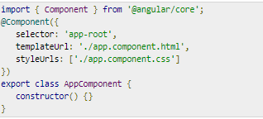
The app.component.ts is as shown below −
Let us now add the material-css support in styles.css.

Slide 21
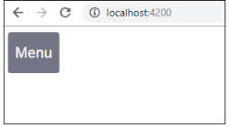
To add menu, <mat-menu></mat-menu> is used. The file and Save As items are added to the button under mat-menu. There is a main button added Menu. The reference of the same is given the <mat-menu> by using [matMenuTriggerFor]="menu" and using the menu with # in<mat-menu>.
The below image is displayed in the browser −

Slide 22
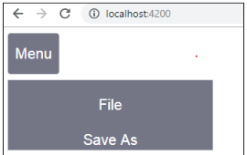

Slide 23


Slide 24


